Slide 1
Welcome to Marketing Management
Dr. Cecilia Ruvalcaba
BUSI 107 Week 7, Day 1

Slide 2


Slide 3

Agenda
Chapter 4: Marketing Ethics Cont…
NO CLASS WEDNESDAY MARCH 2!!!
See Canvas Posts.
View Videos and Read Articles Posted
Extended Outline due Friday 3/11

Slide 4
Title Page
Table of Contents
Executive Summary
Introduction
Objectives
Marketing Program
Product Strategy
Marketing Communication and Promotion Strategy
Pricing Strategy
Distribution Strategy
Corporate Social Responsibility Strategy
Situational Analysis
Industry Analysis
The Cooperative Environment
The Competitive Environment
The Economic Environment
The Social/Cultural Environment
The Political Environment
The Legal Environment
The Technological Environment
SWOT
Target Market Analysis
Customer Analysis (primary and secondary research)
Recommendations
Summary/Conclusion
Appendixes (must include at least 1)
List of references
Notes:
http://www.starbucks.com/

Slide 5
• Title Page, Table of Contents, Executive Summary
•Product Description: 2-liter cartons of take-home ice cream in flavors found in the American market, offering large chunks of candy or add-ins.
• Specific Opportunity and Rationale:
Germany is ranked #7 in market size for all countries in the Ice Cream category with sales increasing year over year (7% in 2013) and is expected in 2017 to have a value of $5,159 million, an increase of 22.5% since 2012 but lacks a sharable-sized ice cream product that can be purchased at the grocery store with American flavors and large chunks. Current available products are predominantly single serving sizes or ice cream bars and found in single flavors such as chocolate, strawberry and vanilla.
•Economic Analysis
Economic Statistics and Activity: Because our company hopes to use local resources to develop our product, we require looking at the country’s agricultural resources: potatoes, wheat, barley, sugar beets, fruit, cabbages; milk products; cattle, pigs and poultry are all available. Our findings concluded that ice cream - a milk based product - would be a benefit to produce with the added options of fruit or candy based flavors. The German workforce is comprised of the following: 69 percent are in services, 30 percent are in industry and .8 percent are in agriculture. Because of these statistics, it can be determined that a supply of workers are available to work for our company. In the CIA world factbook; food and beverages were identified as one of the main industries within Germany. Additionally, the exchange rate of The Euro - which is the currency for Germany - has become 0.7634 to the dollar.
Channels of Distribution- Ice cream is mainly bought in hypermarkets, supermarkets and discounters, yet small grocers have a higher share than in most other categories of packaged food.
Notes:
Cultural Analysis
Geographical Setting (location, climate, topography): Germany is located in western-central Europe. As Europe's largest economy and second most populous nation - after Russia - Germany has terrain such as: coastlines, rolling plains, forested hills, flat plains, mountains and large, highly populated cities. Germany’s climate is temperate and marine, with cool winters, warm summers and occasional warm mountain wind.
Language: German is the official language and is spoken almost universally.
Economic Analysis
Population (Total, Distribution…) The total population of Germany is almost 81 million people, with Berlin comprising of about 3.3 million. The majority of the population is considered Ethnic German, with 2.4 percent of Turks and 6.1 percent of “other groups” comprising the remaining population. With a total of 41.7 percent, the German populace are mostly in the age range of 25-54 years old.

Slide 6
Chapter 4: Marketing Ethics Continued…

Slide 7
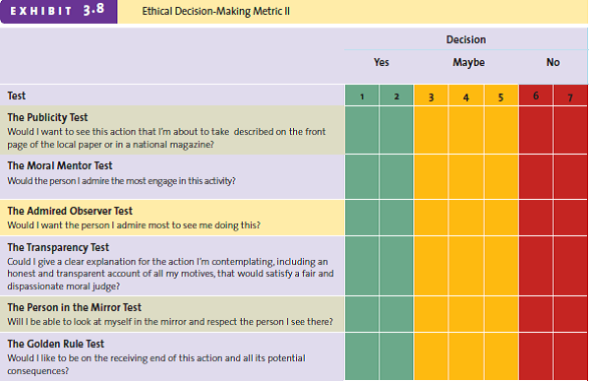

Slide 8
The Ethical Decision Making Process
Step 1
Step 2
Step 3
Step 4
Identify Issues
Gather information and identify stakeholders
Brainstorm and evaluate alternatives
Choose a course of action

Slide 9
Ethics & Corporate Social Responsibility (CSR)
Socially Responsible
Socially Irresponsible
Both ethical and socially
responsible
Ethical firm not involved
with the larger
community
Ethical
Questionable firm
practices, yet donates a
lot to the community
Neither ethical nor
socially responsible
Unethical
Notes:
Philip Morris: http://www.pmi.com/eng/pages/homepage.aspx

Slide 10
Corporate Social Responsibility
Employees
Their families
Current customers
Potential customers
Employees
Customers
Marketplace
Society
Partners
Competitors
Community
Environment

Slide 11
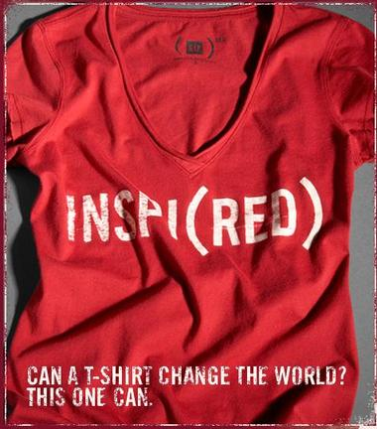

Corporate Social Responsibility
Opportunity to build your brand
Notes:
http://www.red.org/en/U2

Slide 12
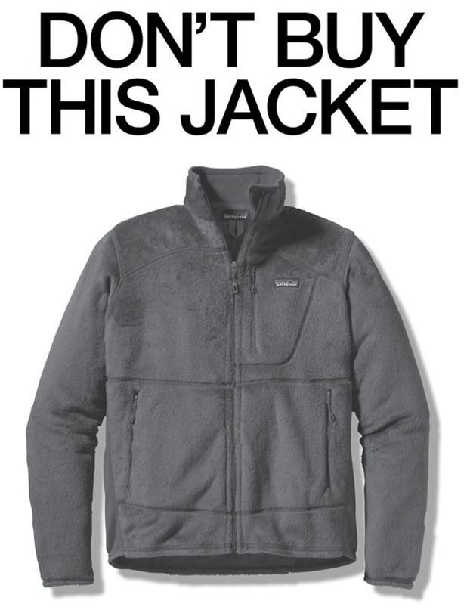
Building your Brand with Social Responsibility
Corporate Social Responsibility (CSR)
A company’s obligation to pursue goals and policies that are in society’s best interests.
Why:
Non-sustainable marketing hurts a company’s relationships with customers and its long-term survival.
Changing value systems and the empowerment of consumers will continue to increase the importance of sustainable marketing.
Integrating social and environmental causes into products leads to long-term loyalty.
Financial gains by companies that integrate sustainability into their core businesses.
We have always believed Starbucks can – and should — have a positive impact on the communities we serve. One person, one cup and one neighborhood at a time.

Slide 13
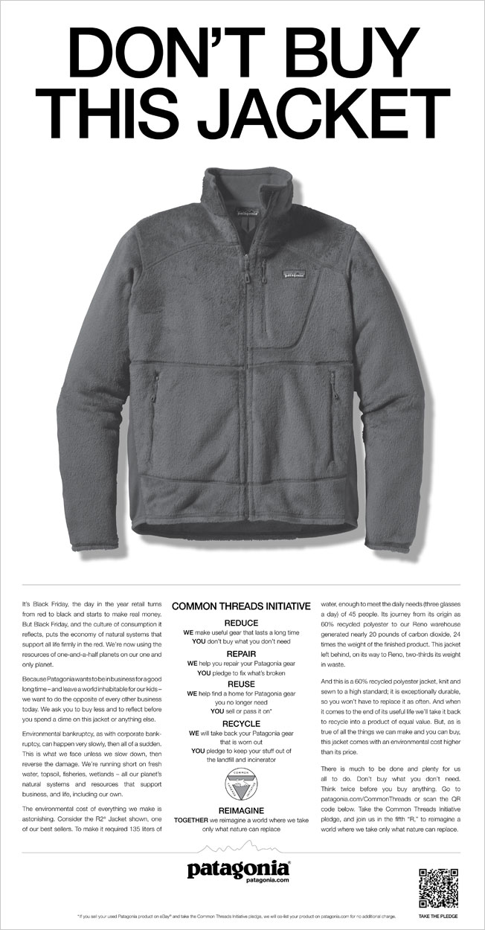

Slide 14
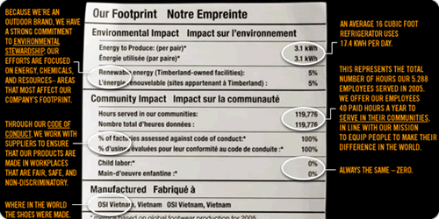
Timberland

Slide 15



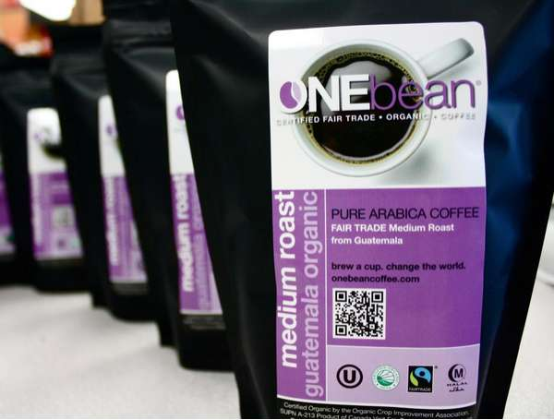
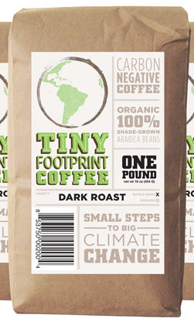
Packaging
Socially Responsible Packaging
Green Labels
What does your package say about your brand?
Notes:
http://www.upworthy.com/never-before-have-i-laughed-so-hard-at-one-guys-non-attempt-to-save-the-planet

Slide 16


Take Away for Today
Corporate Social Responsibility
No Longer an Option!
Doing good for society also does good for the company
Embrace the competitive strategy

Slide 17

Next Class
NO CLASS WEDNESDAY MARCH 2!!!
See Canvas Posts.
View Videos and Read Articles Posted
Friday Start Chapter 11: Product, Branding, and Packaging Decisions & Chapter 12: Developing New Products
Extended Outline due Friday 3/11

